Slide 1
Name | James Small
Git Hash | 414a4c29b40e505e68a63cd4912131eb806027b3
Sprint number | Start date | end date | Work hard rating
1 | 21/03/2022 | 31/03/2022 | 4 out of 5

Slide 2
KANBAN board at the start of the sprint
None

Slide 3
Screenshot of the game at the start of the sprint
None

Slide 4
Sprint Reflection and summary
I believe I did a good amount of work for this sprint, I was able to establish a working base game of a spaceman moving through space around asteroids. With help from Cameron I was able to create movement for the player sprite. It has acceleration in all directions and deceleration in all directions, the sprite is also able to rotate which also has deceleration.
I also converted the game window into a game view, because the end game is to ran through arcade.views.
I ran into some issues learning how to merge and create branches on GitHub, we also had some problems with flake8 configurations which meant every time we committed it told us there was a problem. From help of an external friend I was able to fix the configurations and get lint and syntax working again.
I would’ve wanted to have physics engine implemented for meteor collisions but I turned out to be difficult to do with the arcade physics engine, so I’m having to learn Pymunk to do this so I wans t able to implement this in sprint 1.
But overall for the first sprint I believe we’ve done well in setting up a base game and getting the fundamentals of the game underway, so that we can build and expand the game in future sprints.

Slide 5
Briefly describe other team members contributions
Cameron has done a large chunk of this sprint in designing the player sprite asset/and player sprite asset with a gun and the first enemy sprite. He also helped me out with creating the movements for the player sprite as well.
Cameron also got camera centred in the player set up, meaning the player can explore the map with ou hitting the edges of the window.

Slide 6
Major Changes and Achievements Described

Slide 7
Brief Description of your testing

Slide 8
Link to testing results/tables

Slide 9
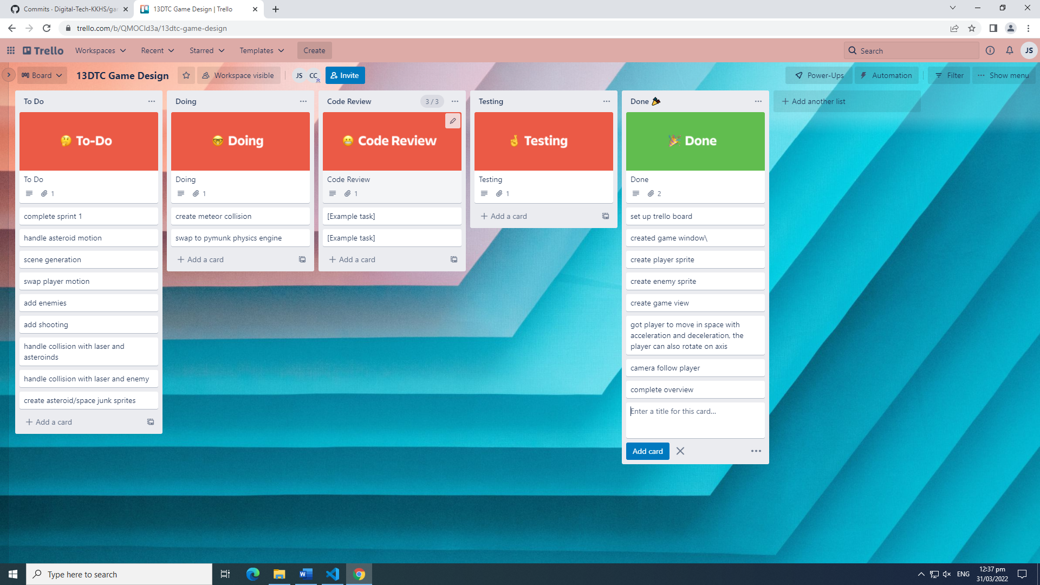
KANBAN board at the end of the sprint

Slide 10
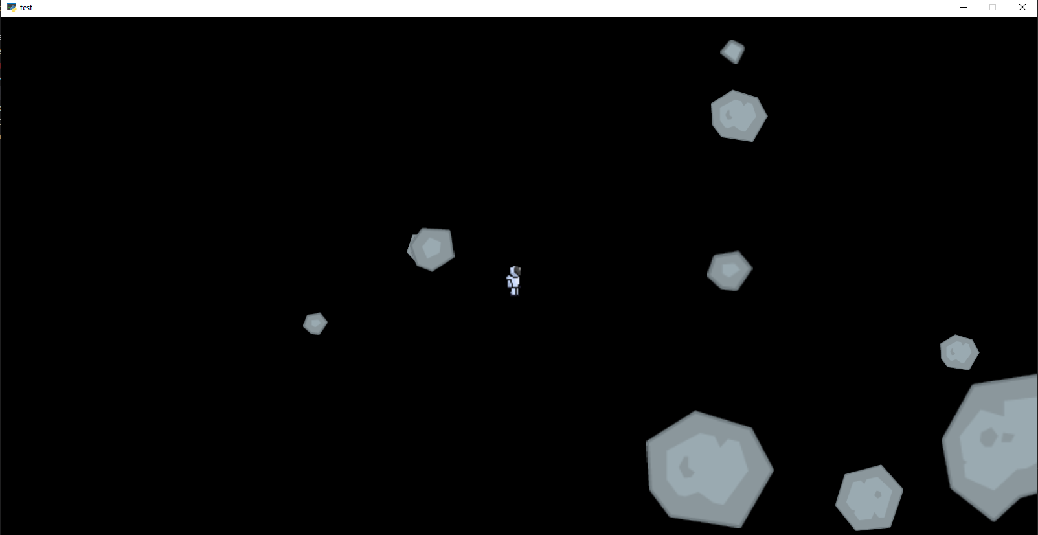
Screenshot of the game at the end of the sprint

Slide 11
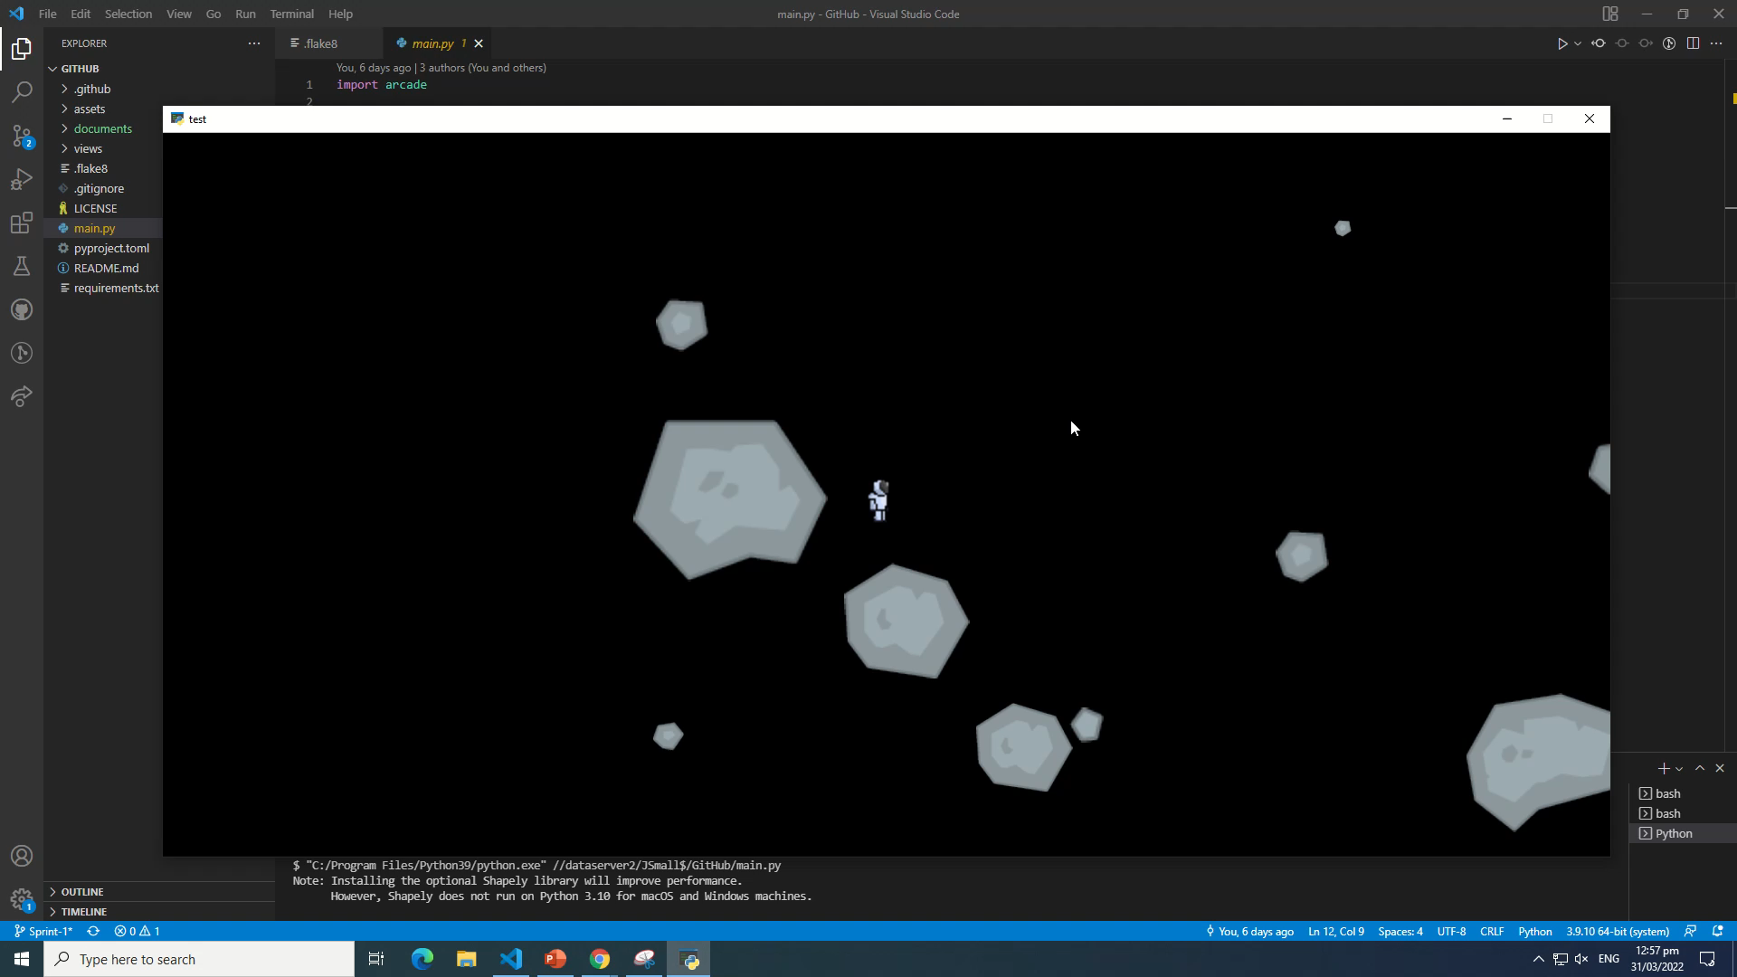
Video of the game at the end of the sprint

Slide 12
Notes for next time, future improvements

